Slide 1
Statistics and R short course
Session 2: Data visualisation Marc Henrion, Vester Gunsaru

Slide 2
Introduction

Slide 3

Preliminaries
Certificates of attendance
You need to attend all 6 sessions.
Sign in & check spelling of name on the sign-in sheet!
Only issued if paid-up and in exchange for completed feedback form.
Course website / GitHub: https://github.com/mlw-stats/R_And_Statistics_Training_Autumn2024
Office hours
Vester - Thursdays 10 & 17 October @ 2pm; Monday 21 October @2pm; DMSU meeting room
Eva - Tuesdays @ 2pm; DMSU meeting room
Marc - Friday 11 October @ 2pm; Monday 21 October @ 9am; Ruo room
Housekeeping
Refreshments (no lunch - sorry)
Fire exits & bathrooms

Slide 4
Learning outcomes
KNOW R: Explain know what R is & what it can do.
KNOW R RESOURCES: List useful R resources and access them.
DO R: Perform basic operations relevant for your research in R:
Read data into R & write data or results to the harddrive.
Manipulate & use different object types.
Write & use functions in R
Perform basic analyses on a dataset: mean, standard deviation, linear regression.
Produce various standard graphs and tables
UNDERSTAND BASICS OF STATISTICS: Explain basic statistical theory: common distributions, standard statistical techniques, common study designs, assumptions behind common statistical tests and regression models.
UNDERSTAND STUDY DESIGNS: Recommend appropriate designs & analyses.
COMPREHEND OPEN SCIENCE: Summarise principles of open, reproducible research.
DO OPEN SCIENCE WITH R: Use R scripts, R markdown, packages & GitHub.

Slide 5
Grammar of graphics

Slide 6
Basic figures & graphs
R has powerful data visualisation capabilities, especially when you start using packages.
The standard R visualisation library is graphics, which is installed when you install R and loaded automatically at start-up. The main function here is plot().
However, the graphics package is quite basic and has inconsistent syntax and function names for different types of graphs.
The tidyverse comes with the R package ggplot2 which provides a more consistent way of producing graphs (it is based on a grammar of graphics).
For example, let’s do a scatter plot.

Slide 7
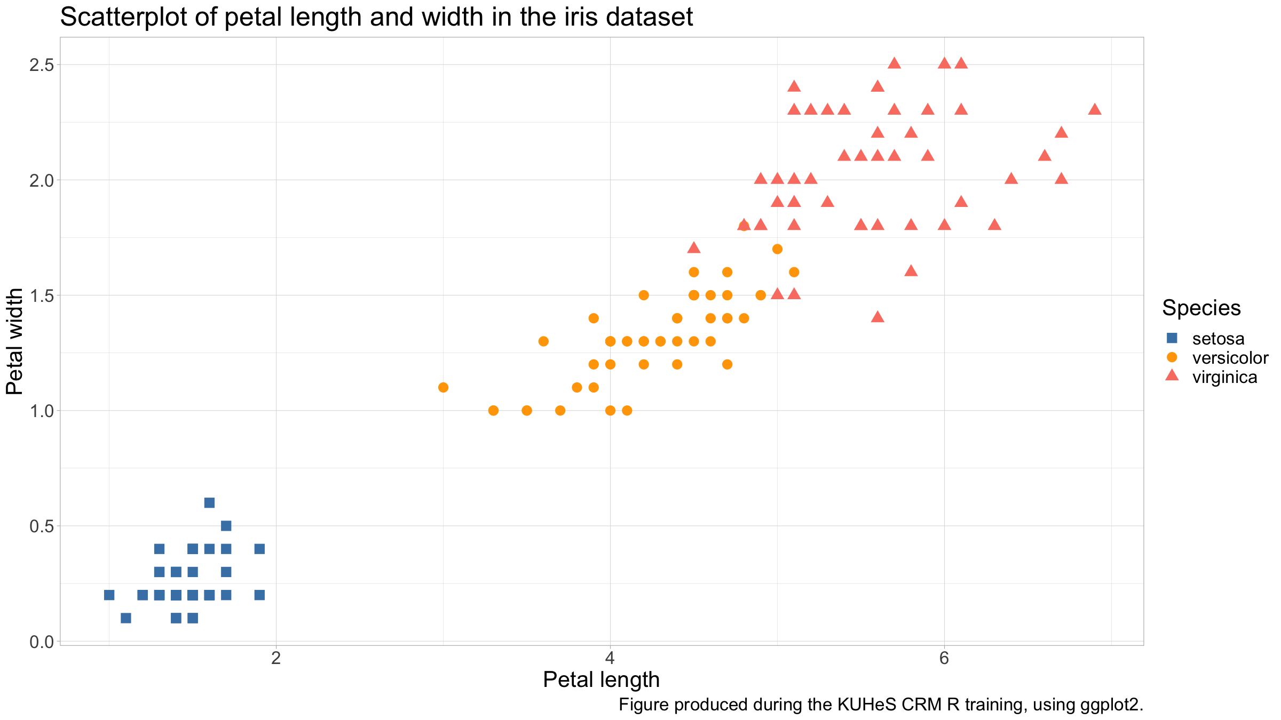
Basic figures & graphs
iris %>% ggplot(mapping=aes(x=Petal.Length,y=Petal.Width,col=Species,pch=Species)) + geom_point() + scale_colour_manual(values=c("steelblue","orange","salmon"),name="Species") + scale_shape_manual(values=15:17,name="Species") + xlab("Petal length") + ylab("Petal width") + labs(title="Scatterplot of petal length and width in the iris dataset",caption="Figure produced during the KUHeS CRM R training, using ggplot2.") + theme_light()

Slide 8
Basic figures & graphs
The aesthetic (the aes() call in the above) defines what you will see, i.e. the data you will plot.
The geom will define the geometry, i.e. how you will plot the data.
The coordinate system governs the data representation.
The theme defines the visual style (background, major & minor axes, font face & size, default colour scales, margins, text alignment, …).

Slide 9
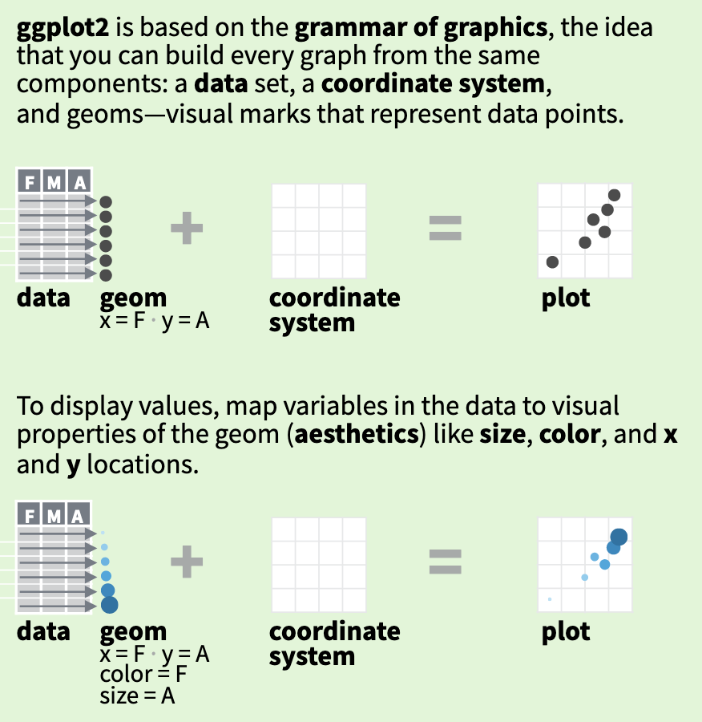
Basic figures & graphs
The basics behind ggplot2 (https://github.com/rstudio/cheatsheets/raw/master/data-visualization.pdf).

Slide 10
Basic figures & graphs
It would not make much sense, but we could decide to plot the same data from before not as a scatterplot but as a line graph.
All we need to do is to change the geom from geom_point() to geom_line().

Slide 11
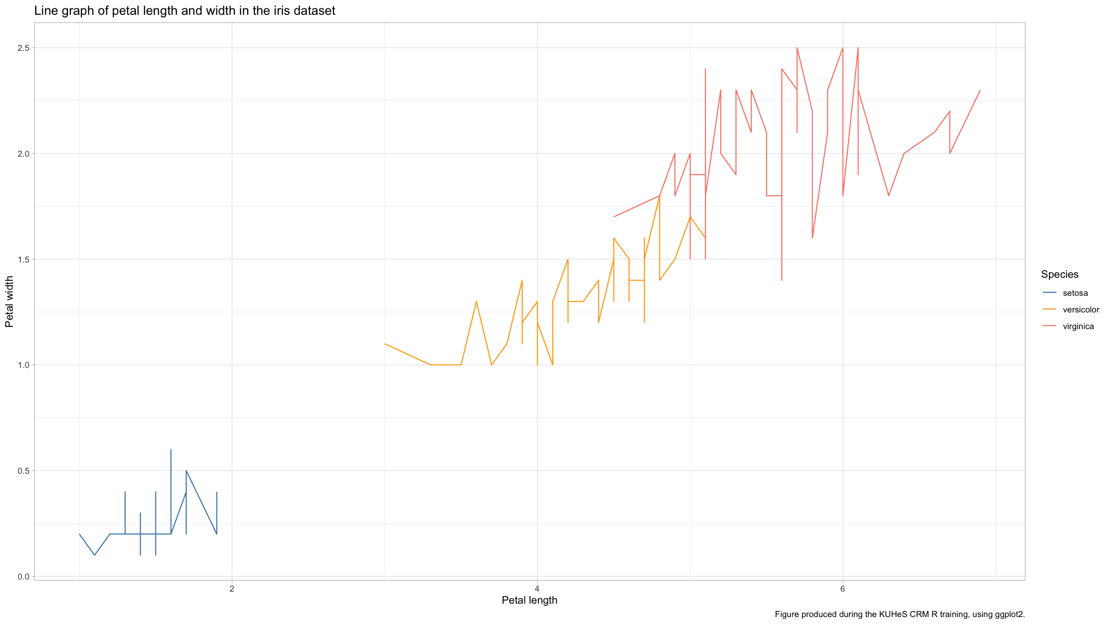
Basic figures & graphs
iris %>% ggplot(mapping=aes(x=Petal.Length,y=Petal.Width,col=Species,pch=Species)) + geom_line() + scale_colour_manual(values=c("steelblue","orange","salmon"),name="Species") + scale_shape_manual(values=15:17,name="Species") + xlab("Petal length") + ylab("Petal width") + labs(title="Line graph of petal length and width in the iris dataset",caption="Figure produced during the KUHeS CRM R training, using ggplot2.") + theme_light()

Slide 12
Basic figures & graphs
Even for very different graphs, there is very similar code to write with ggplot2.
You can also use more than one geom on the same graph.

Slide 13
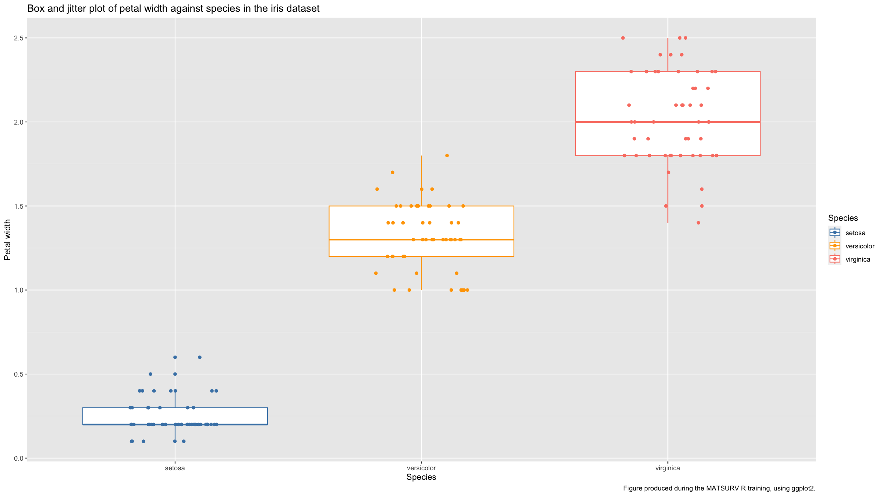
Basic figures & graphs
iris %>% ggplot(mapping=aes(x=Species,y=Petal.Width,col=Species)) + geom_boxplot() + geom_jitter(height=0,width=0.2) + scale_colour_manual(values=c("steelblue","orange","salmon")) + scale_fill_manual(values=c("steelblue","orange","salmon")) + xlab("Species") + ylab("Petal width") + labs(title="Box and jitter plot of petal width against species in the iris dataset",caption="Figure produced during the MATSURV R training, using ggplot2.")

Slide 14
Resources

Slide 15
Resources
The R Graph Gallery is an excellent resource to get started when you have a specific plot in mind that you want to do for your data.
The ggplot2 cheat sheet is another excellent resource.

Slide 16
Distribution figures

Slide 17
Distribution figures
Distributions: what values did you record for a given variable?
Discrete values (nominal, ordinal, integer-valued) values:
bar plots
pie charts
Continuous values
histograms
Let’s generate some data.

Slide 18
Distribution figures
typesTmp<- paste(sep="","type",1:3) type<-factor(sample(typesTmp, size=1000, replace=T, prob=c(0.45,0.3,0.25))) x1<-rbinom(1000,size=1,prob=0.25) x2<-rpois(1000,lambda=ifelse(type=="type3",6,4))

Slide 19
Distribution figures
dat<-data.frame(type,x1,x2) %>% mutate(x3=ifelse(type=="type1", rnorm(sum(type=="type1"),mean=-2), ifelse(type=="type2", rnorm(sum(type=="type2"),mean=2), runif(sum(type=="type3")) ) ) ) %>% mutate(x4=rnorm(n(),mean=x3))

Slide 20
Distribution figures
Bar plots simply show bars the height of which is proportional to the relative frequency of the different levels of a categorical variable in your dataset.
In ggplot2, the geom to use for barplots is geom_barplot().
On the next few slides we generate simple bar plots for 3 variables.

Slide 21
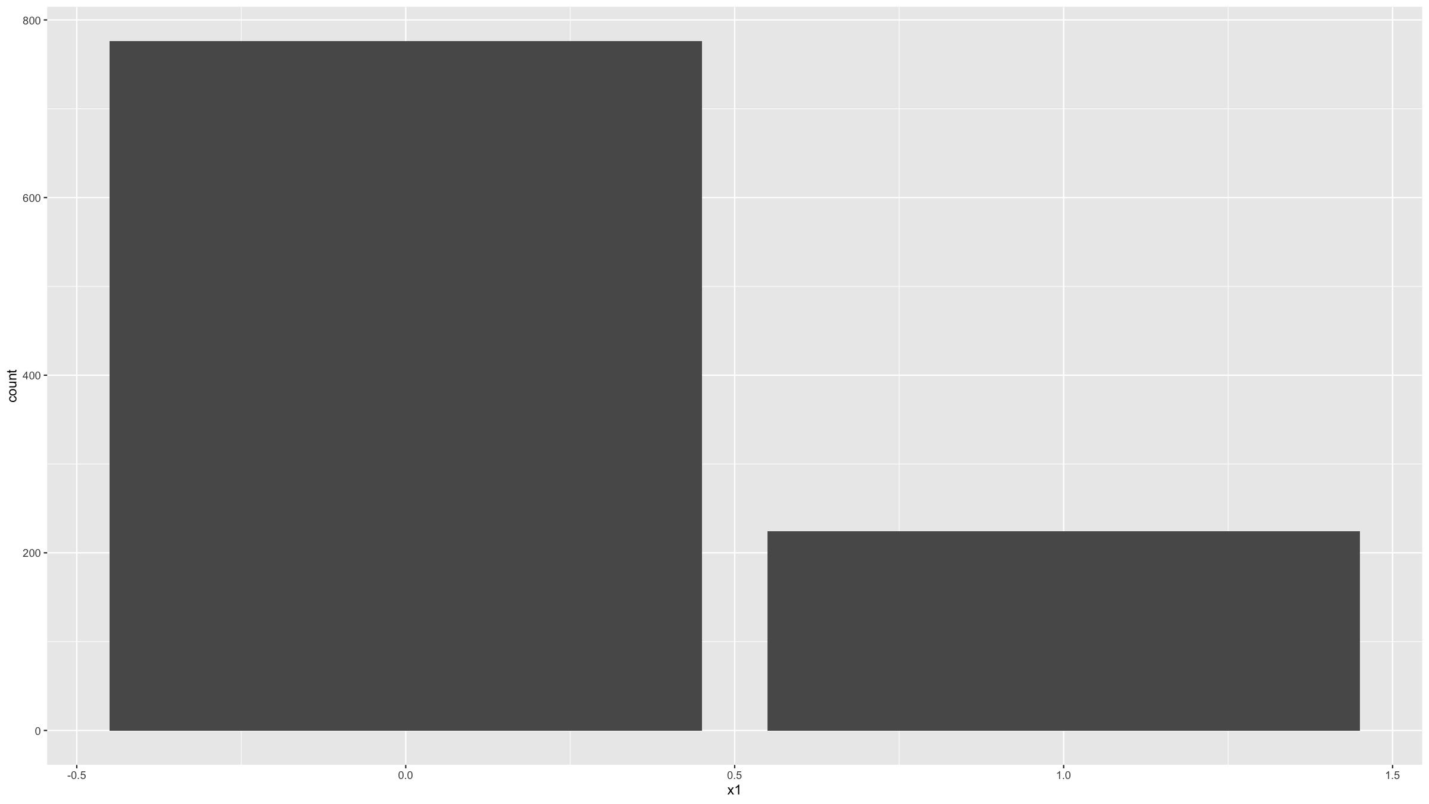
Distribution figures
ggplot(data=dat,mapping=aes(x=x1)) + geom_bar()

Slide 22
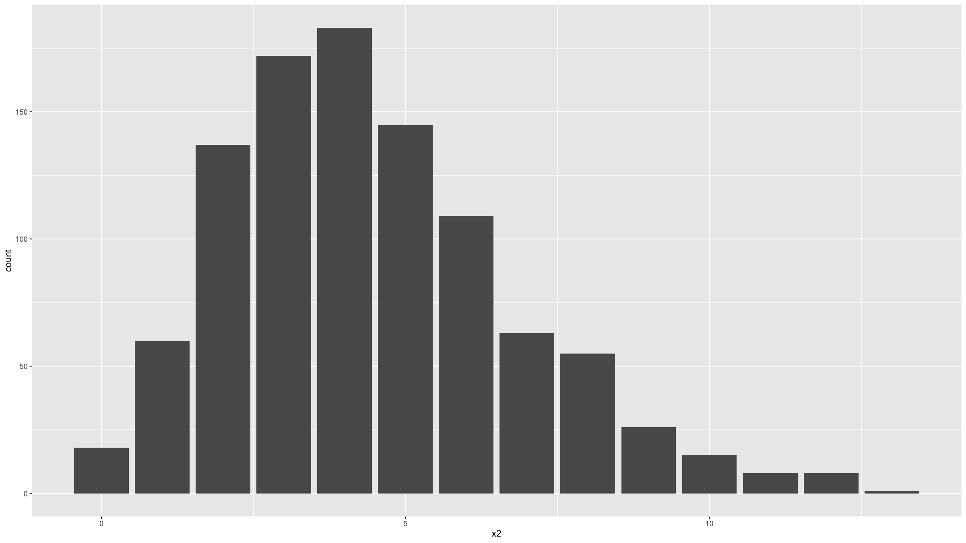
Distribution figures
ggplot(data=dat,mapping=aes(x=x2)) + geom_bar()

Slide 23
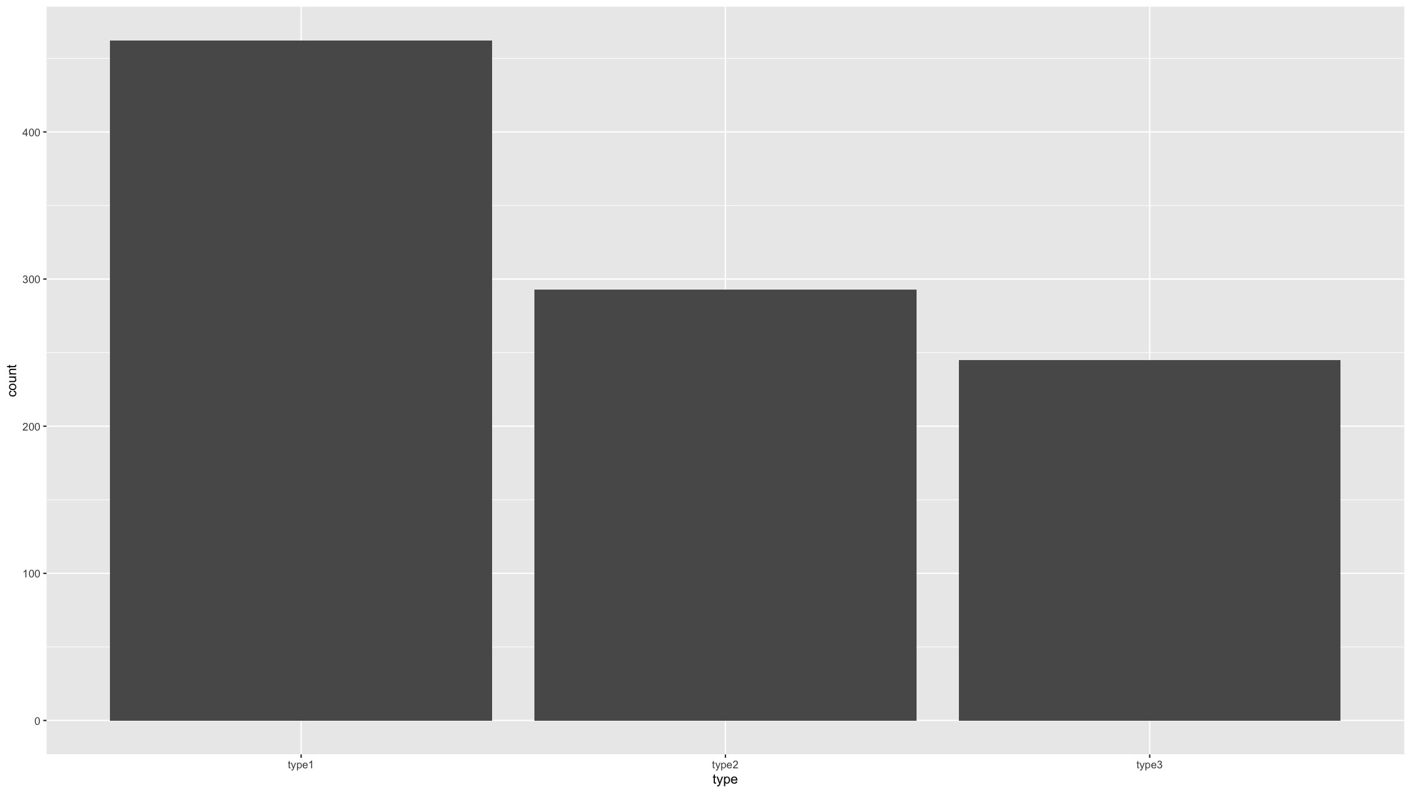
Distribution figures
ggplot(data=dat,mapping=aes(x=type)) + geom_bar()

Slide 24
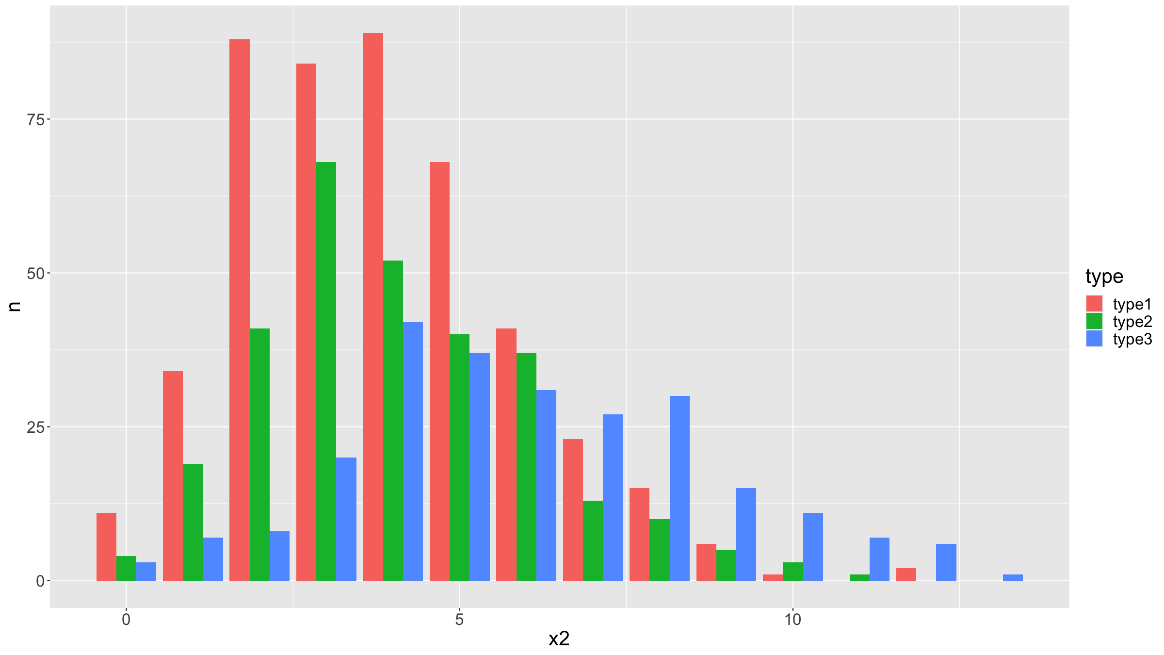
Distribution figures
We can stratify a bar plot by a grouping variable (in this case the variable type).
dat %>% count(type,x2) %>% complete(type,x2,fill=list(n=0)) %>% ggplot(mapping=aes(fill=type,y=n,x=x2)) + geom_bar(position="dodge",stat="identity") + theme(text = element_text(size=20))

Slide 25
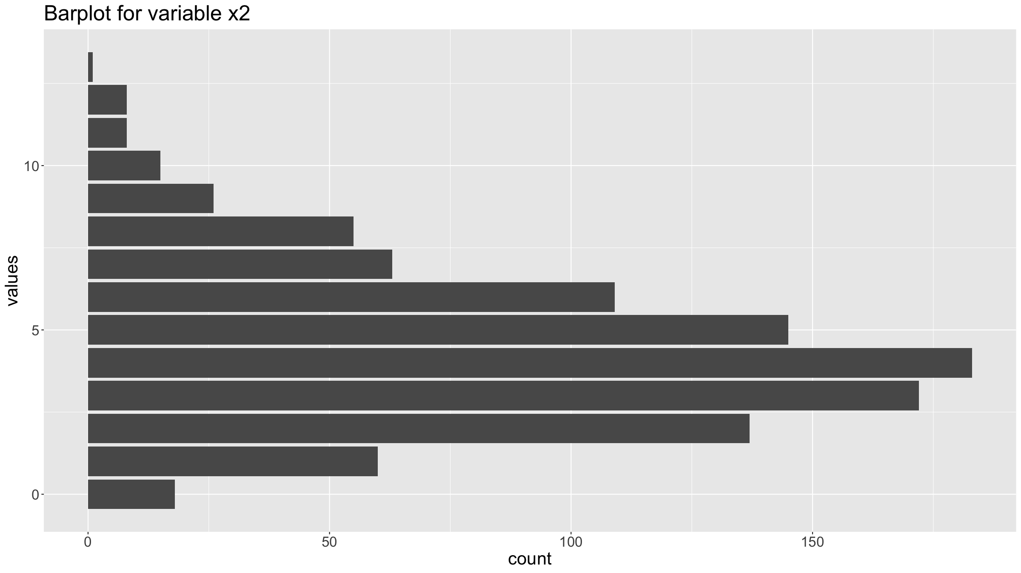
Distribution figures
You can customise graphs by adding other options for the coordinate system, the annotations, the theme etc.
ggplot(data=dat,mapping=aes(x=x2)) + geom_bar() + coord_flip() + ggtitle("Barplot for variable x2") + xlab("values") + ylab("count") + theme(text = element_text(size=20))

Slide 26
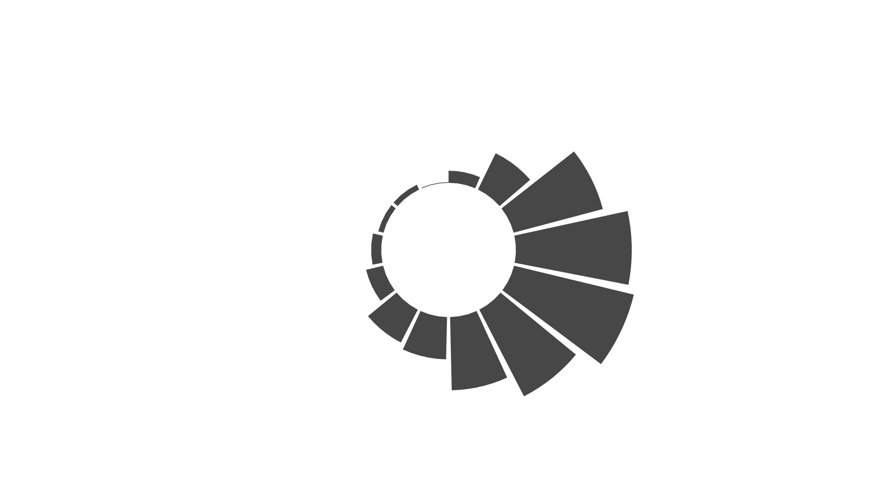
Distribution figures
You can change the coordinate system to get a circular plot (note, use these carefully - most often they are NOT a good idea).
For this you can use coord_polar().
To get annotations for each bar, requires a bit more work (but see the R Graph Gallery for examples).
ggplot(data=dat,mapping=aes(x=x2)) + geom_bar() + coord_polar(start=0) + theme_minimal() + theme( axis.text = element_blank(), axis.title = element_blank(), panel.grid = element_blank(), plot.margin = unit(rep(-2,4), "cm") # removing unnecessary margins ) + ylim(-100,250) # dtermines size of the inner radius

Slide 27
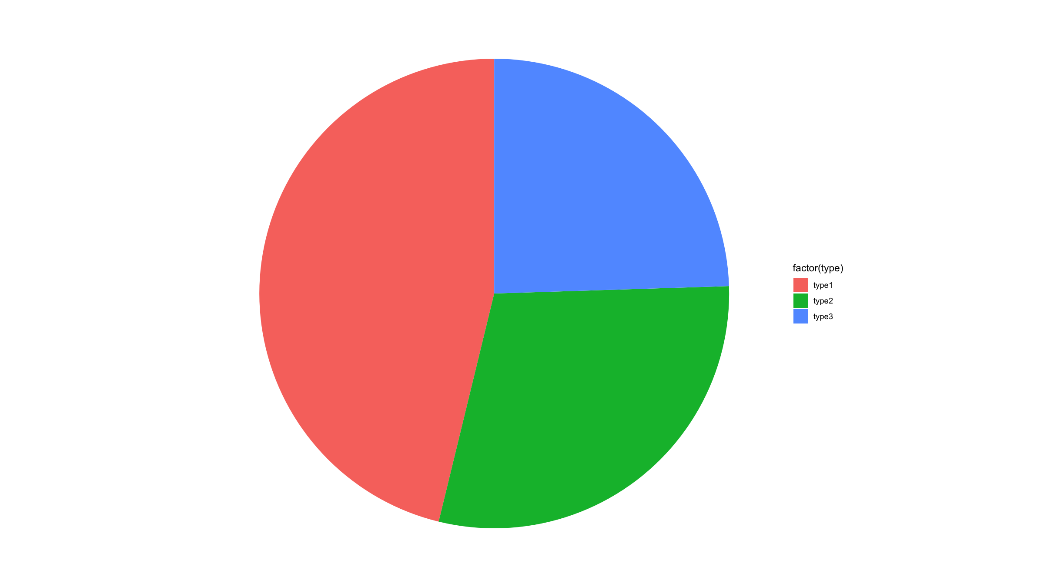
Distribution figures
In ggplot2, pie charts are just bar charts with a special (polar) coordinate system.
ggplot(dat, mapping=aes(x=factor(1), fill=factor(type))) + geom_bar(width = 1) + coord_polar("y") + xlab("") + theme_void()

Slide 28
Distribution figures
Note:
Generally, R discourages the use of pie charts (they are horrible & misleading - human brains are not good at judging the relative sizes of areas).

Slide 29
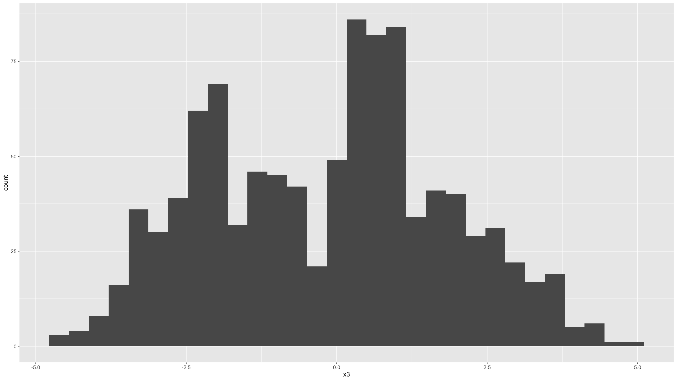
Distribution figures
Histograms are useful graphs. They:
Summarise the distribution of continuous variables, by binning data into discrete intervals.
Can be used for binary and discrete variables as well, but barplots better suited for such variables.
In ggplot2, the geom_histogram() is used to generate histograms.
ggplot(data=dat,mapping=aes(x=x3)) + geom_histogram()
## `stat_bin()` using `bins = 30`. Pick better value with `binwidth`.

Slide 30
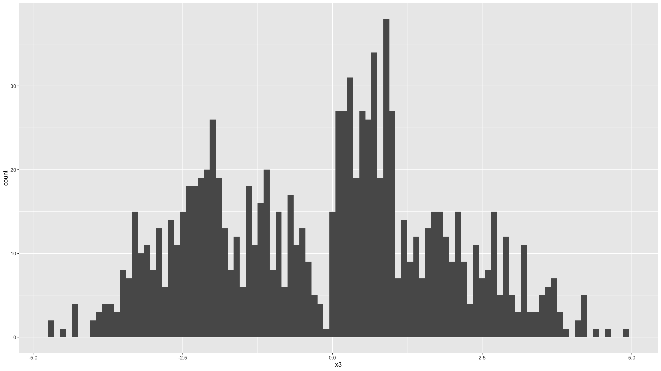
Distribution figures
Note the warning message above. You can ignore this, but R is just trying to tell you that other bin widths / number of bins may work better. You can set this by specifying the bins or the bindwidth parameter.
ggplot(data=dat,mapping=aes(x=x3)) + geom_histogram(binwidth=0.1)

Slide 31
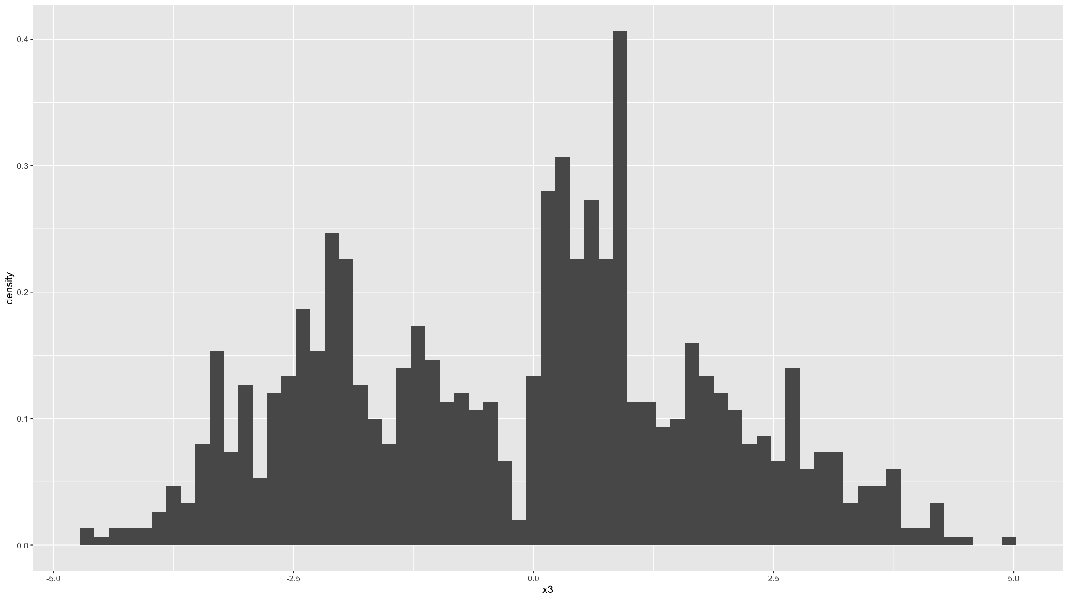
ggplot(data=dat,mapping=aes(x=x3,stat(density))) + geom_histogram(binwidth=0.15)
## Warning: `stat(density)` was deprecated in ggplot2 3.4.0. ## ℹ Please use `after_stat(density)` instead. ## This warning is displayed once every 8 hours. ## Call `lifecycle::last_lifecycle_warnings()` to see where this warning was ## generated.

Slide 32
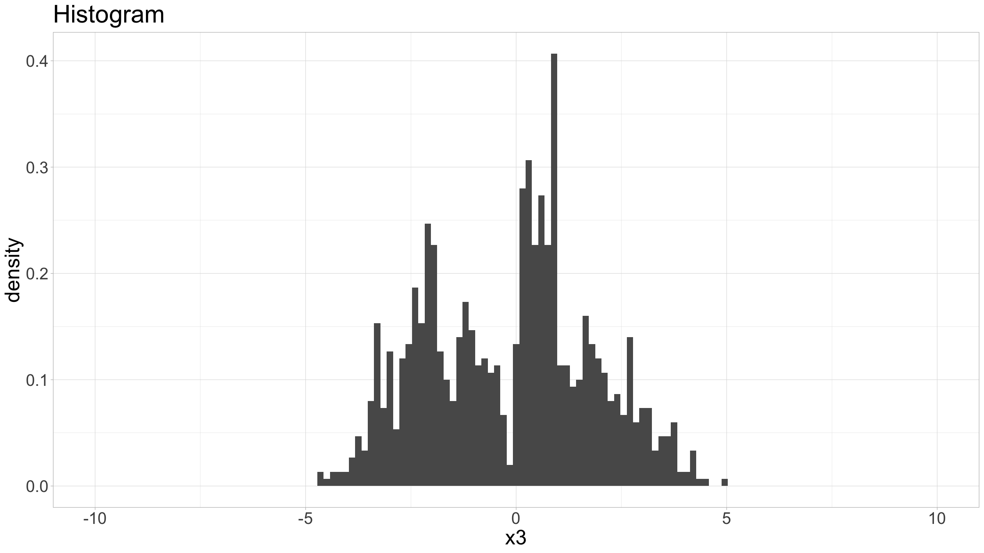
Distribution figures
There’s many other parameters you can specify to customise the histogram graph.
ggplot(data=dat,mapping=aes(x=x3,stat(density))) + geom_histogram(binwidth=0.15) + coord_cartesian(xlim = c(-10, 10)) + ggtitle("Histogram") + theme_light() + theme(text=element_text(size=24))

Slide 33
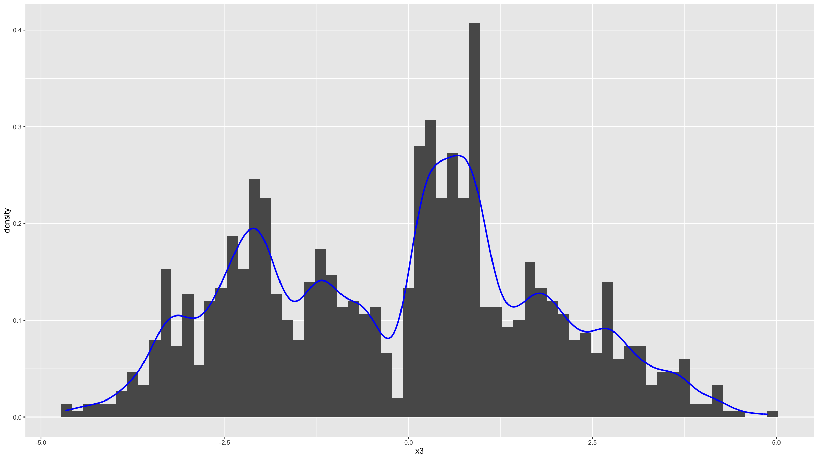
Distribution figures
We can add kernel density estimates for the distribution function.
ggplot(data=dat,mapping=aes(x=x3,stat(density))) + geom_histogram(binwidth=0.15) + geom_density(bw="SJ",col="blue",lwd=1)

Slide 34
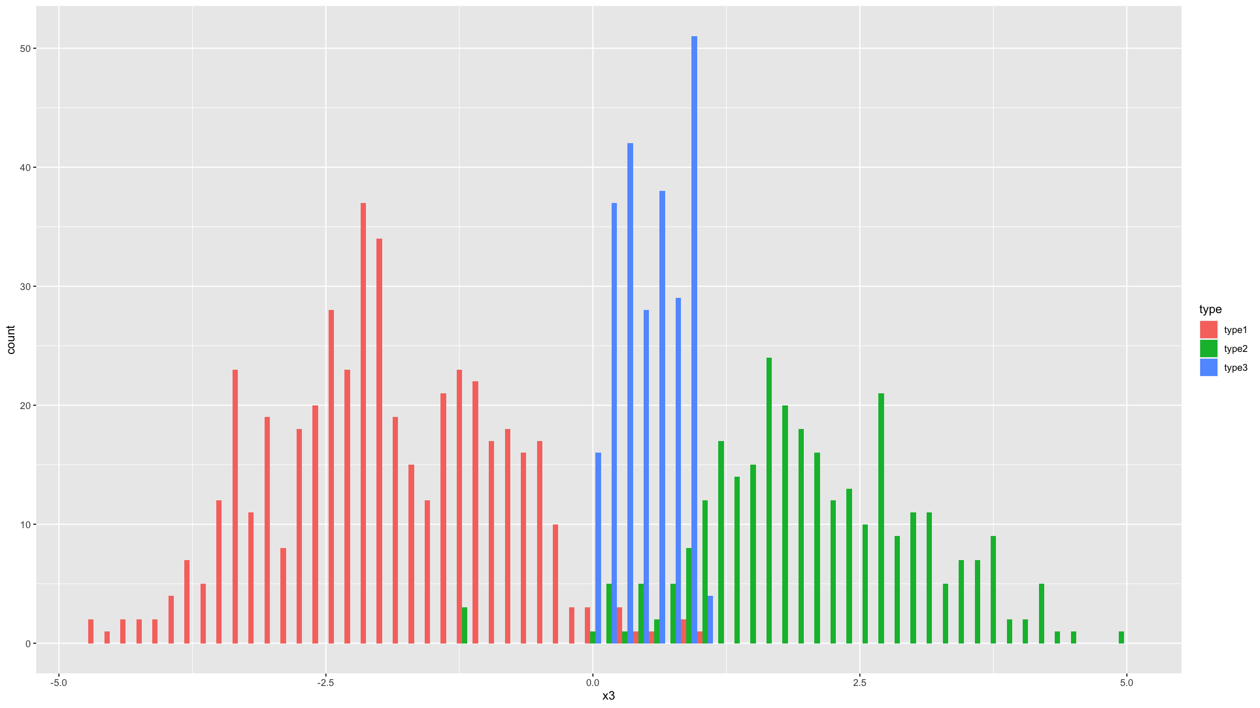
Distribution figures
We can stratify by a grouping variable (variable type in this case).
ggplot(data=dat,mapping=aes(x=x3,fill=type)) + geom_histogram(binwidth=0.15,position="dodge")

Slide 35
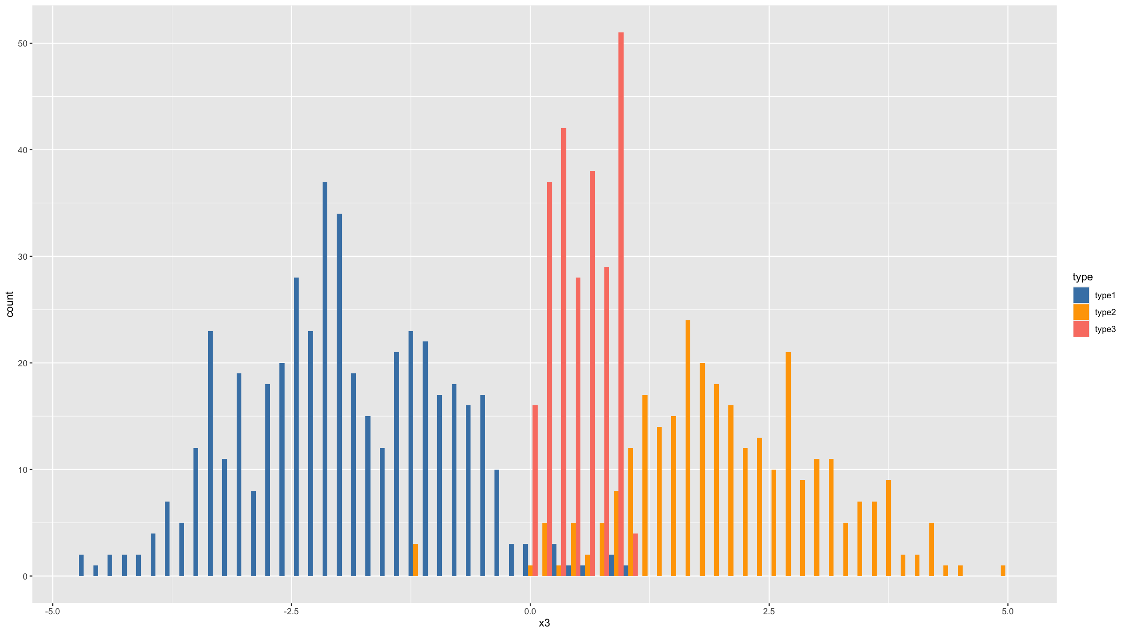
Distribution figures
You can change the default colours that are being used for the type variable.
The aesthetic element governing the colour of the bars is the variable specified by fill=type.
So to change the colours, we need to use the function scale_fill_manual().
ggplot(data=dat,mapping=aes(x=x3,fill=type)) + geom_histogram(binwidth=0.15,position="dodge") + scale_fill_manual(values=c("steelblue","orange","salmon"))

Slide 36
Covariation figures

Slide 37
Covariation figures
Covariation figures let you visually explore whether there is a relationship between 2 or more variables.

Slide 38
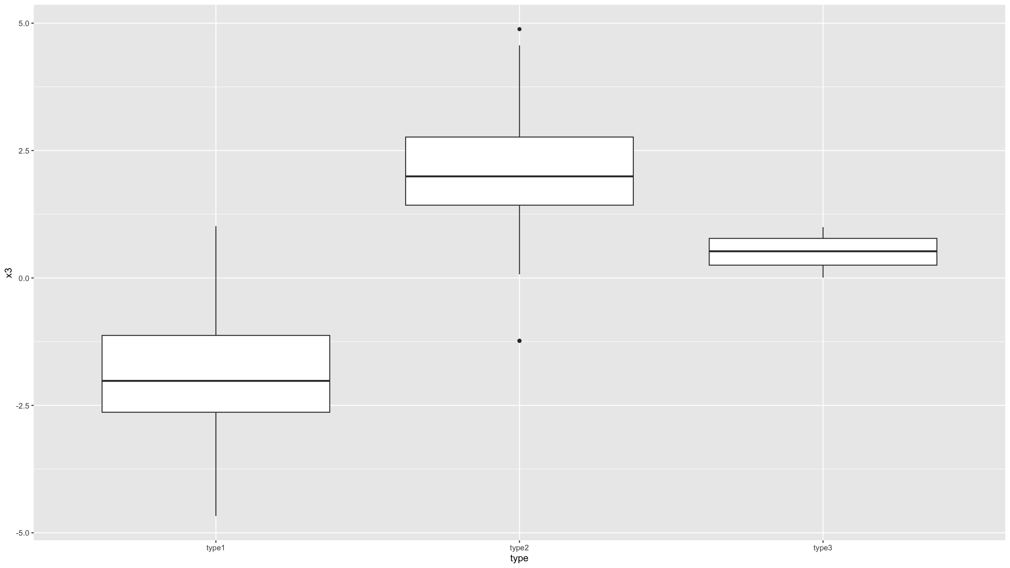
Covariation figures
Boxplots, and their variation violin plots, allow you to explore what, if any, relationship there is between a binary / discrete / categorical and a continuous variable.
For boxplots the geom geom_boxplot() is used is used.
ggplot(data=dat,mapping=aes(x=type,y=x3)) + geom_boxplot()

Slide 39
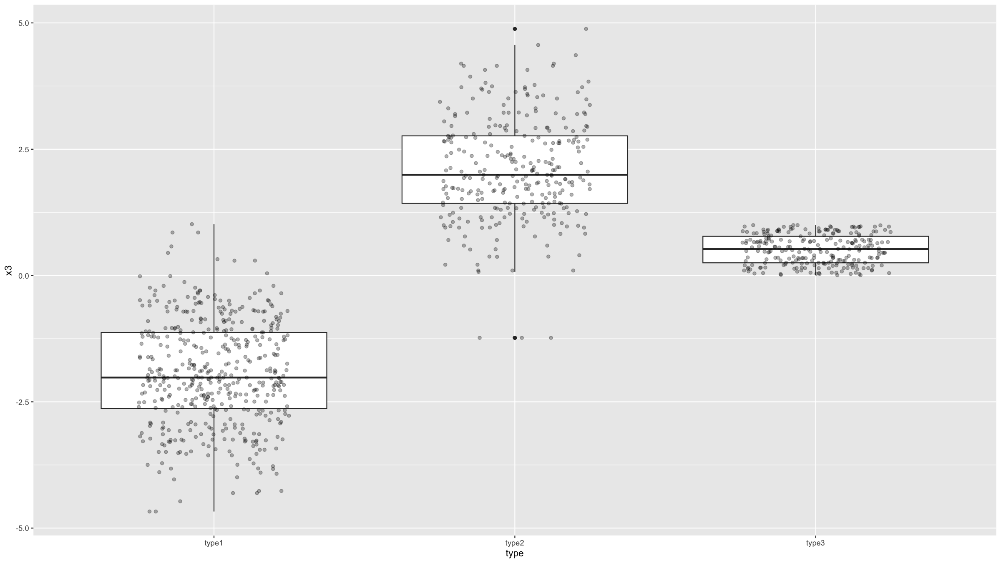
Covariation figures
Often it is nice to add individual data points on top. To better display these (since they all have the same x-axis coordinate), you need to ass jitter to their x-axis coordinates. ggplot2 provides a geom for this: geom_jitter(). By specifying some transparency (the alpha parameter), it is easier to get an idea where the ddata density is highest.
ggplot(data=dat,mapping=aes(x=type,y=x3)) + geom_boxplot() + geom_jitter(width=0.25,height=0,alpha=0.3)

Slide 40
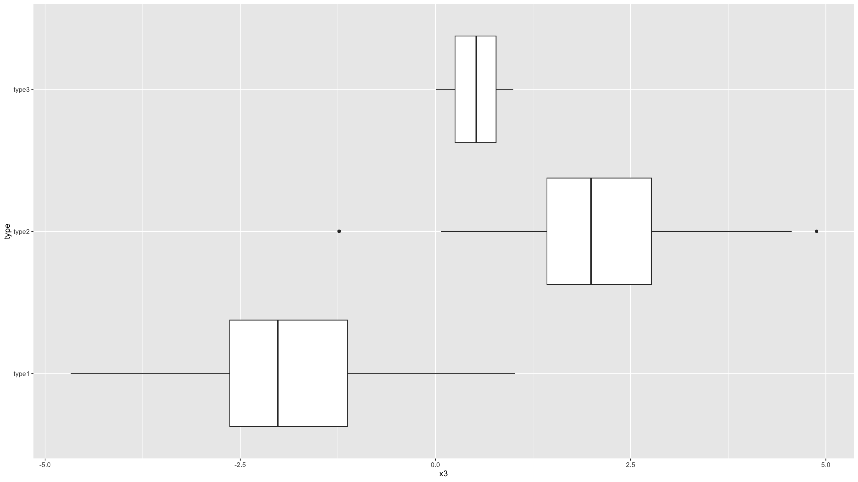
Covariation figures
You can also generate horizontal boxplots, by flipping the coordinate system.
ggplot(data=dat,mapping=aes(x=type,y=x3)) + geom_boxplot() + coord_flip()

Slide 41
Covariation figures
It is important that you understand what information is summarised in a boxplot.

Slide 42
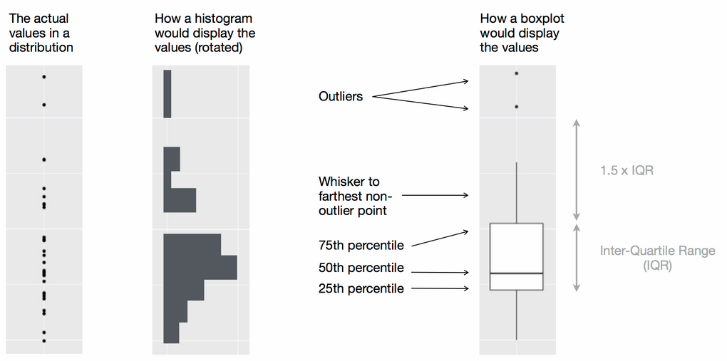
Covariation figures
Wickham, H. & Grolemund G., R for Data Science, O’Reilly, 2016

Slide 43
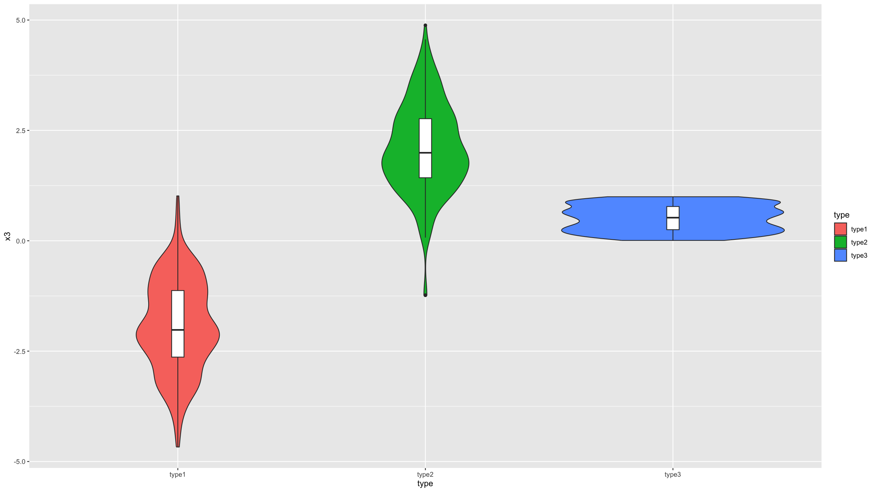
Covariation figures
Violin plots are similar to boxplots, but they combine box plots with histograms.
In ggplot2, the geom geom_violin() is used to generate these types of graphs.
ggplot(data=dat,mapping=aes(x=type,y=x3,fill=type)) + geom_violin() + geom_boxplot(width=0.05, fill="white")

Slide 44
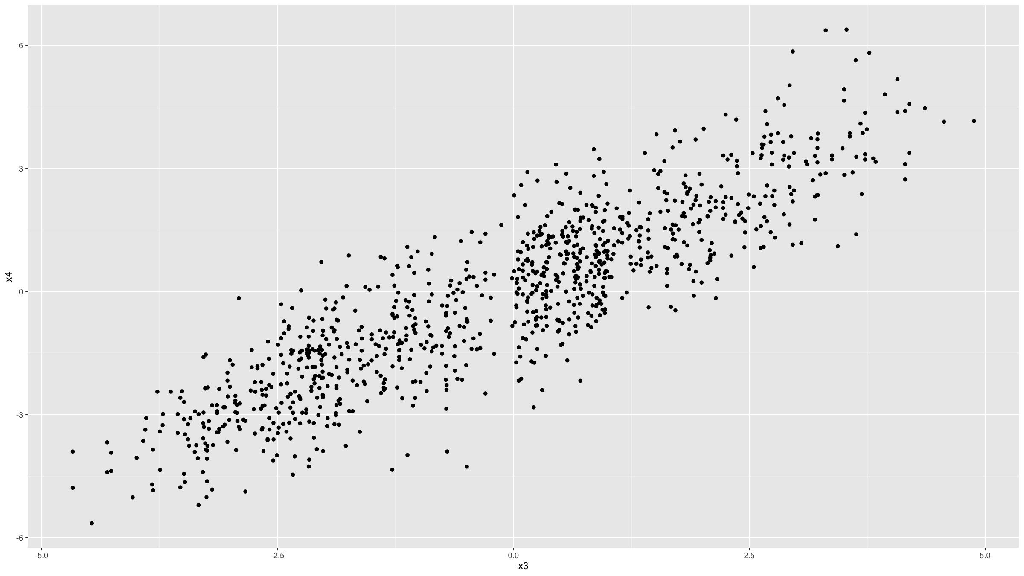
Covariation figures
The scatter plot, which shows 2 continuous variables plotted against each other, is probably the most basic and most used covariation plot.
For example, it is the basis of any graph showing a regression model.
The geom geom_point() is used to generate scatter plots in ggplot2.
ggplot(data=dat,mapping=aes(x=x3,y=x4)) + geom_point()

Slide 45
Covariation figures
This can be customised and you can easily add smooth regression lines with geom_smooth().
Note that the colour of the individual points is given by the col argument and so scale_colour_manual() is used to specify colours (rather than scale_fill_manual() as was used above in the example for histograms).

Slide 46
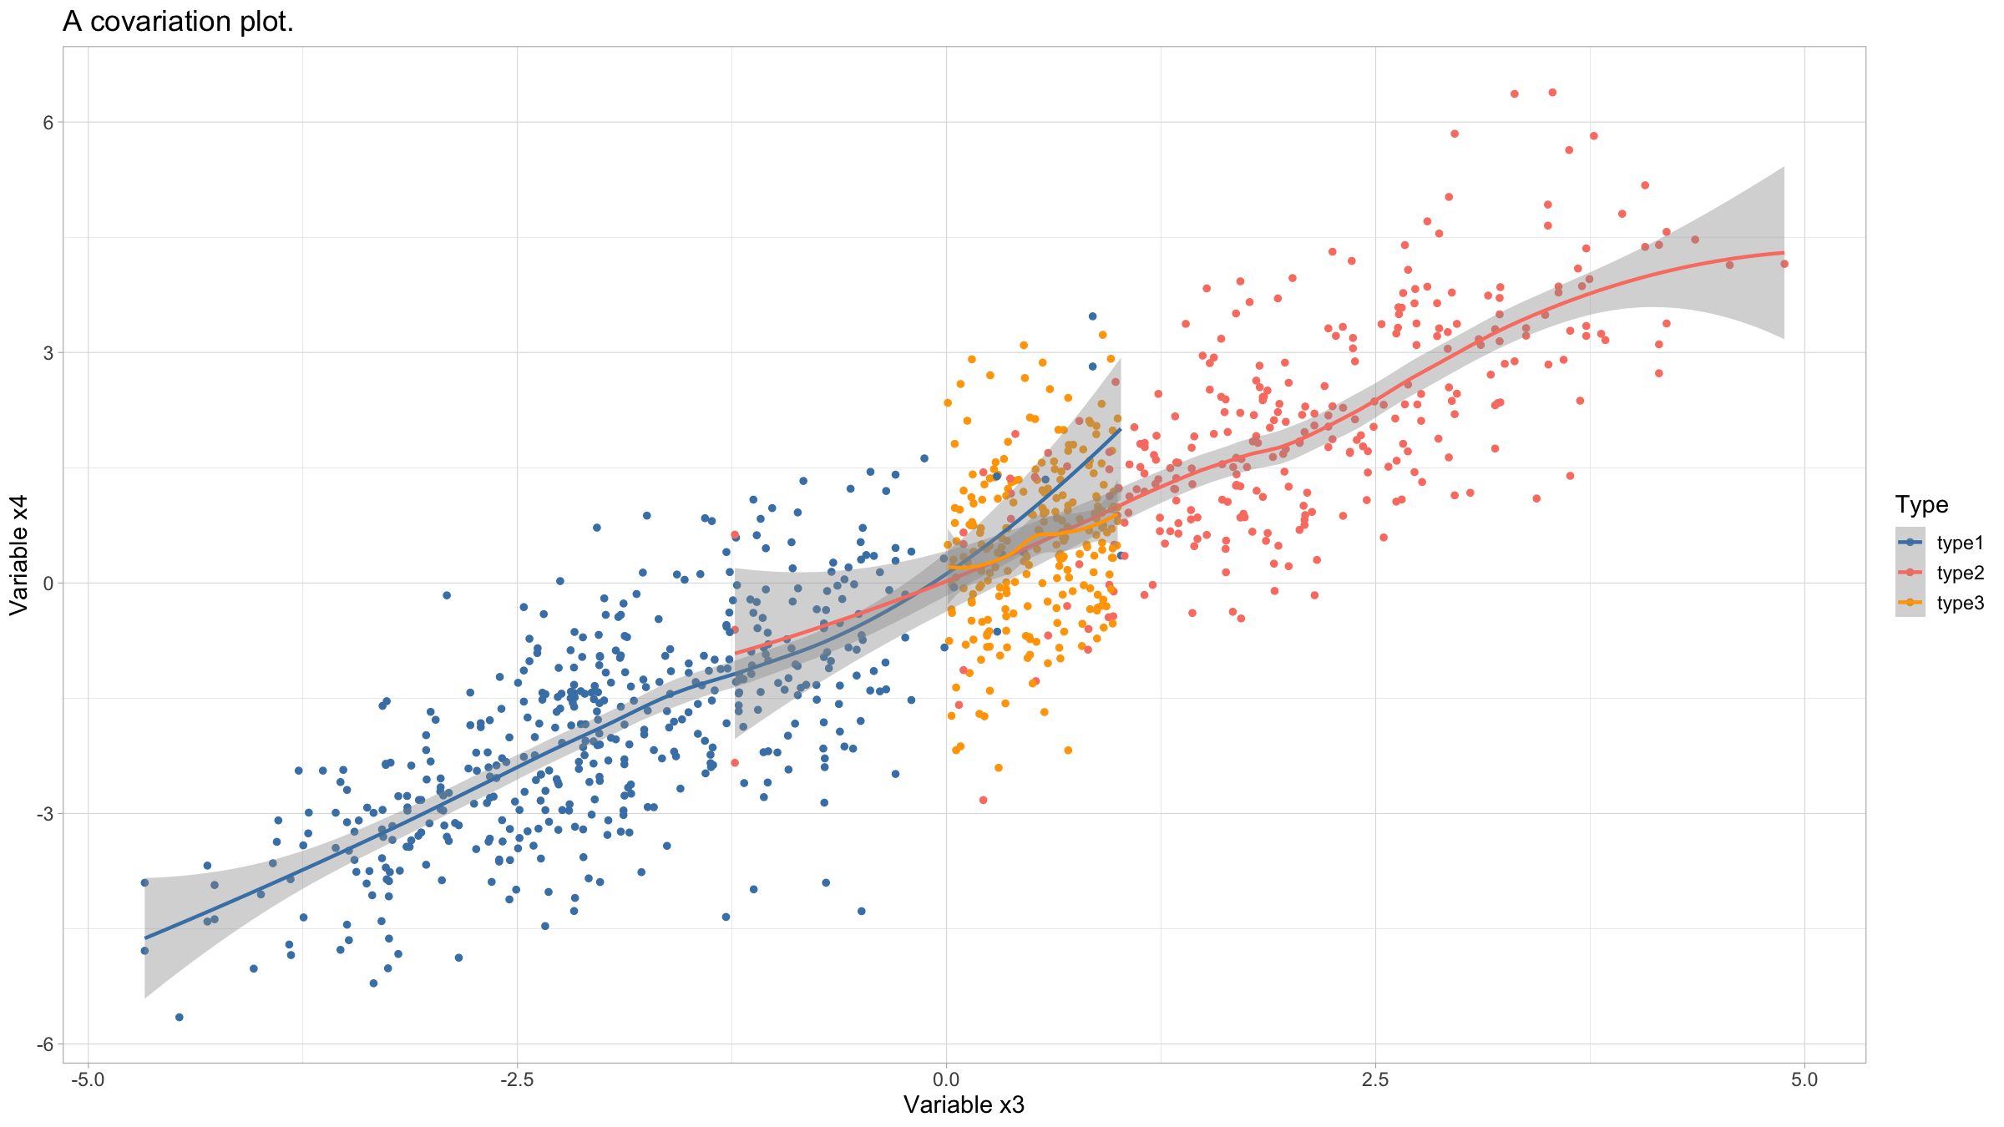
Covariation figures
ggplot(data=dat,mapping=aes(x=x3,y=x4,col=type)) + geom_point() + geom_smooth() + scale_colour_manual(values=c("steelblue","salmon","orange"), name="Type") + xlab("Variable x3") + ylab("Variable x4") + ggtitle("A covariation plot.") + theme_light() + theme(text=element_text(size=14))
## `geom_smooth()` using method = 'loess' and formula = 'y ~ x'

Slide 47
Covariation figures
If one of the 2 variables has an order to it, such as e.g. a time variable, then line graphs may be better suited.
The geom geom_line() is used for this.
For an example, we will use a dataset that comes with R: beavers which consists of body temperature measurements from 2 beavers, stored in data frame beaver1 and beaver2.

Slide 48
Covariation figures
beaver<-rbind(beaver1[beaver1$day==346,],beaver2[beaver2$day==307,]) beaver<-data.frame( name=c(rep("beaver1",sum(beaver1$day==346)), rep("beaver2",sum(beaver2$day==307))),beaver)

Slide 49
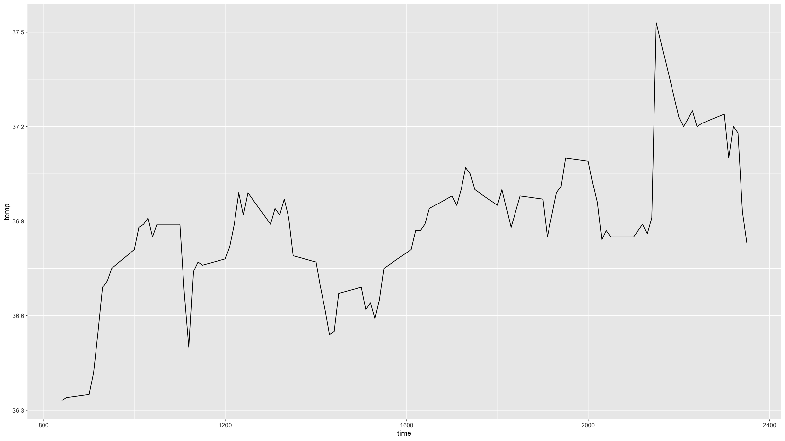
Covariation figures
For a simple line graph, you just need and x and a y variable.
beaver %>% filter(name=="beaver1") %>% ggplot(mapping=aes(x=time,y=temp)) + geom_line()

Slide 50
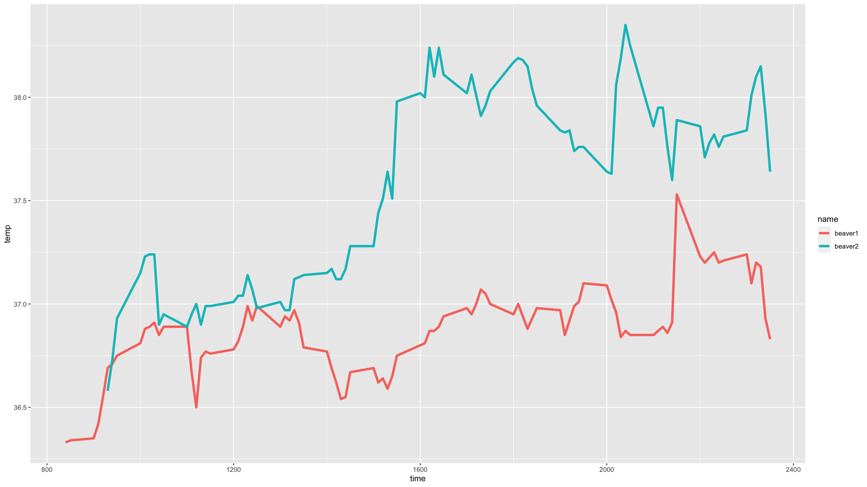
Covariation figures
You can easily stratify a line graph by a grouping variable (in this case the variable name) in ggplot2.
ggplot(data=beaver,mapping=aes(x=time,y=temp,colour=name)) + geom_line(lwd=1.5) # the lwd parameter sets the line width

Slide 51
Covariation figures
Heatmaps are useful to show covariation among 3 variables.
The x- and y-axis show 2 of the variables and the third variable determines the colour of cells.
The variables can be either categorical or continuous.
In ggplot2, one geom that you can use for heatmaps is geom_tile().
First, we need some data.

Slide 52
Covariation figures
dens<-function(x,y){ return( 0.35*dnorm(x)*dnorm(y,sd=1.5) + 0.65*dnorm(x,mean=2,sd=2)*dnorm(y,mean=3) ) } x<-seq(-2.5,6.5,by=0.05) y<-seq(-3,5.5,by=0.05) densSurf<-expand.grid(x=x,y=y) %>% mutate(dens=dens(x,y))

Slide 53
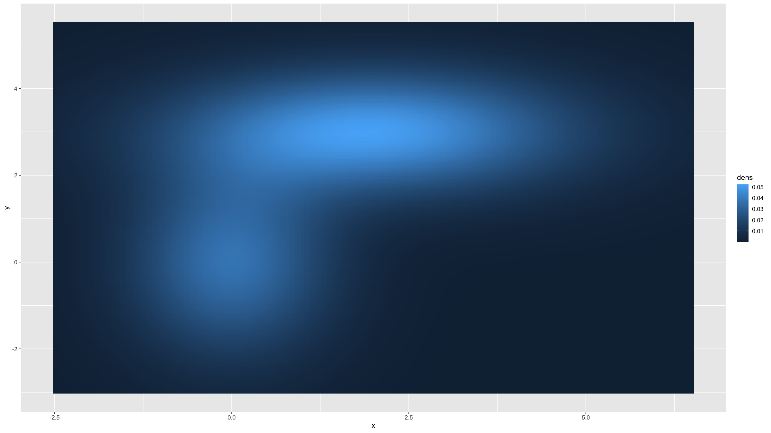
Covariation figures
Then we can do a basic heat map, using default colours.
densSurf %>% ggplot(mapping=aes(x=x,y=y,fill=dens)) + geom_tile(width=0.05,height=0.05)

Slide 54
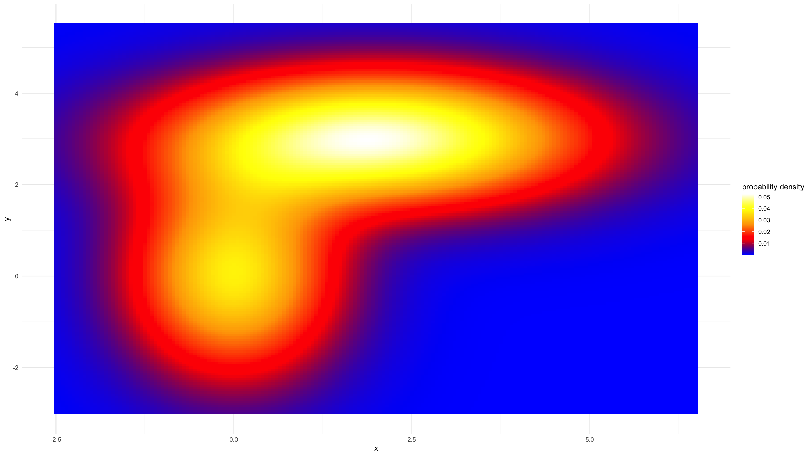
Covariation figures
But we can also provide custom colour scales.
clrs<-colorRampPalette(c("blue","red","orange","yellow","white")) densSurf %>% ggplot(mapping=aes(x=x,y=y,fill=dens)) + geom_tile(width=0.05,height=0.05) + scale_fill_gradientn(colours = clrs(200),name="probability density") + theme_minimal()

Slide 55
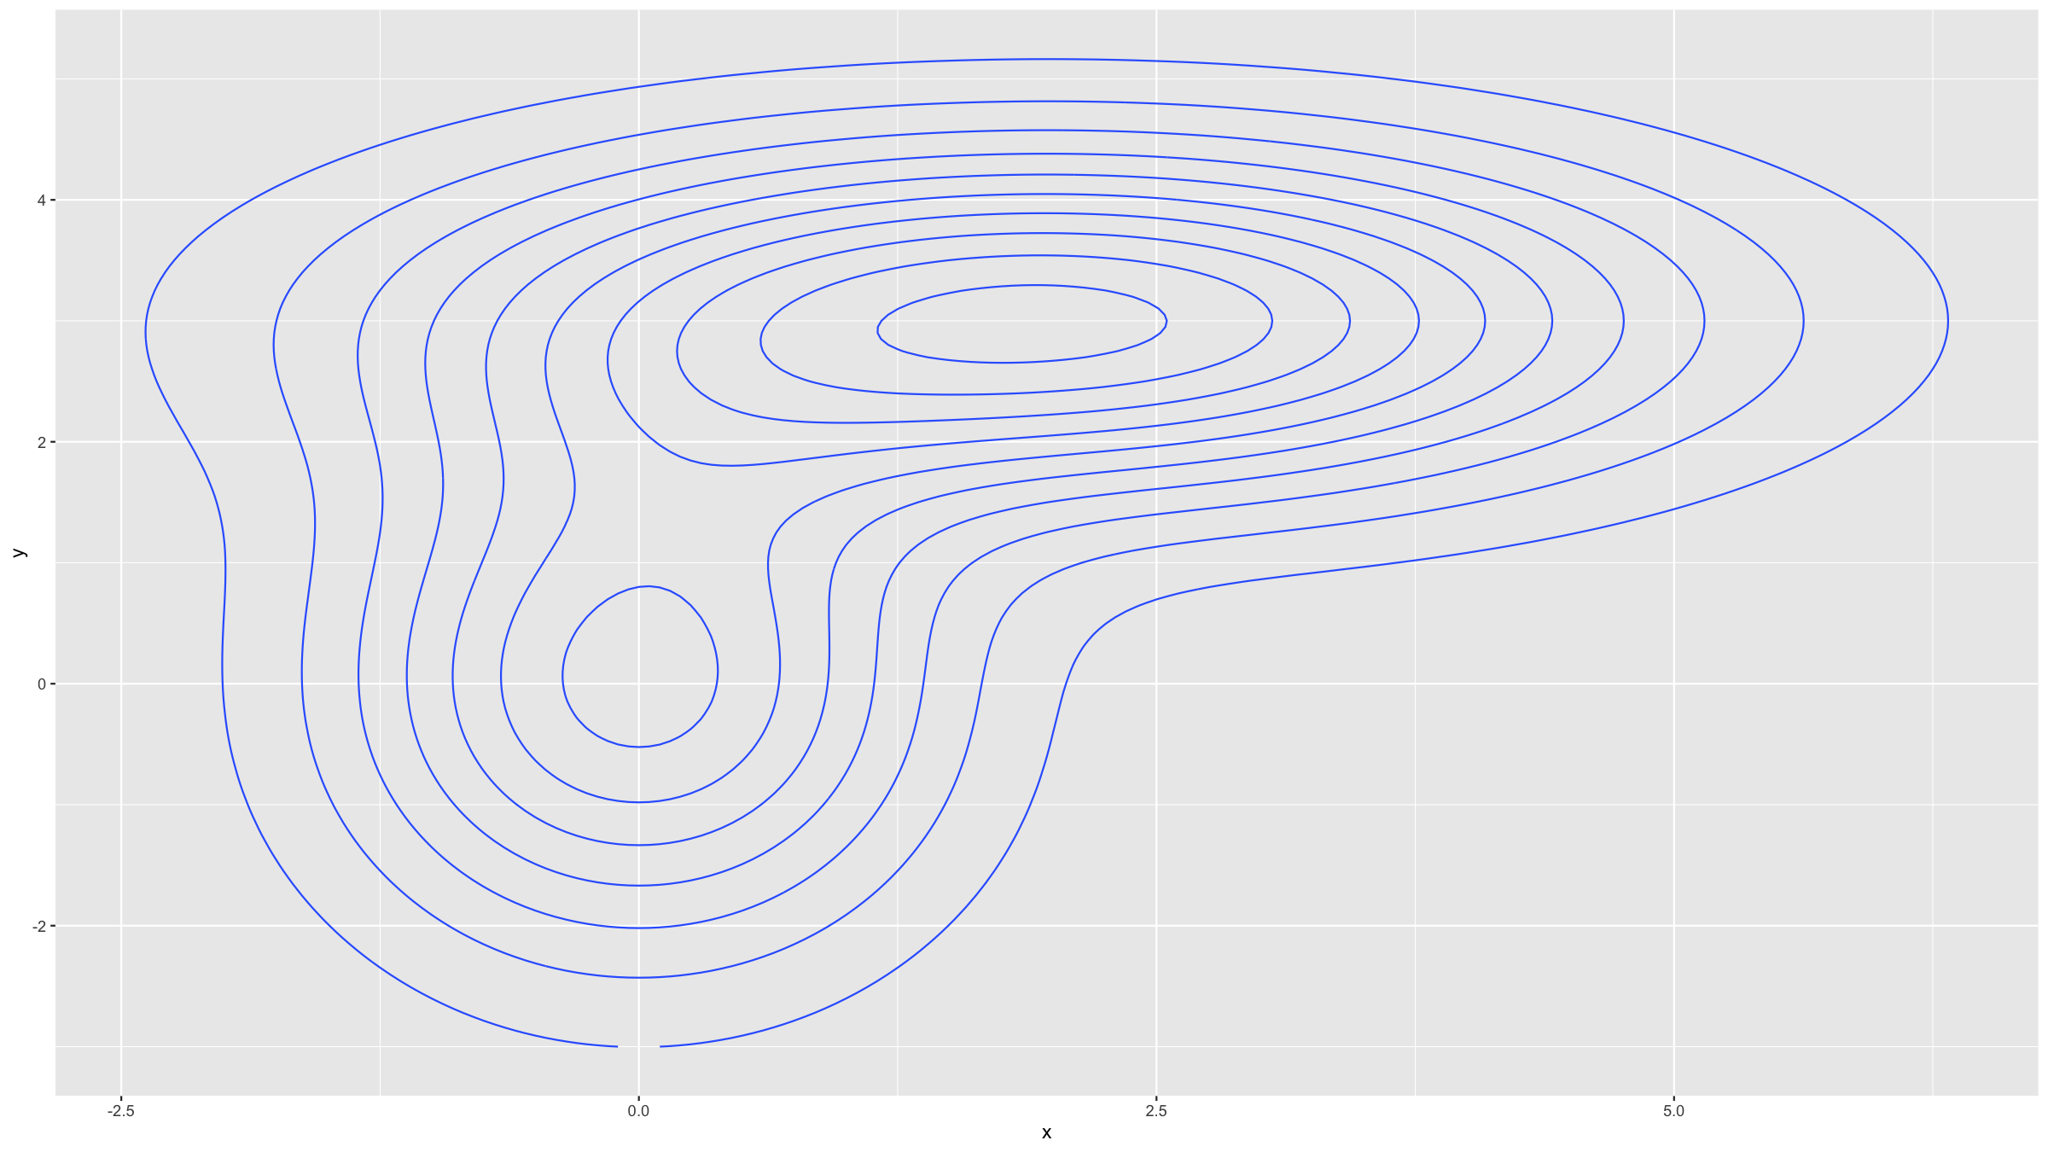
Covariation figures
Contour plots are similar but use contour lines rather than colour scales to show variation in the third variable.
ggplot(data=densSurf,mapping=aes(x=x,y=y,z=dens)) + geom_contour()

Slide 56
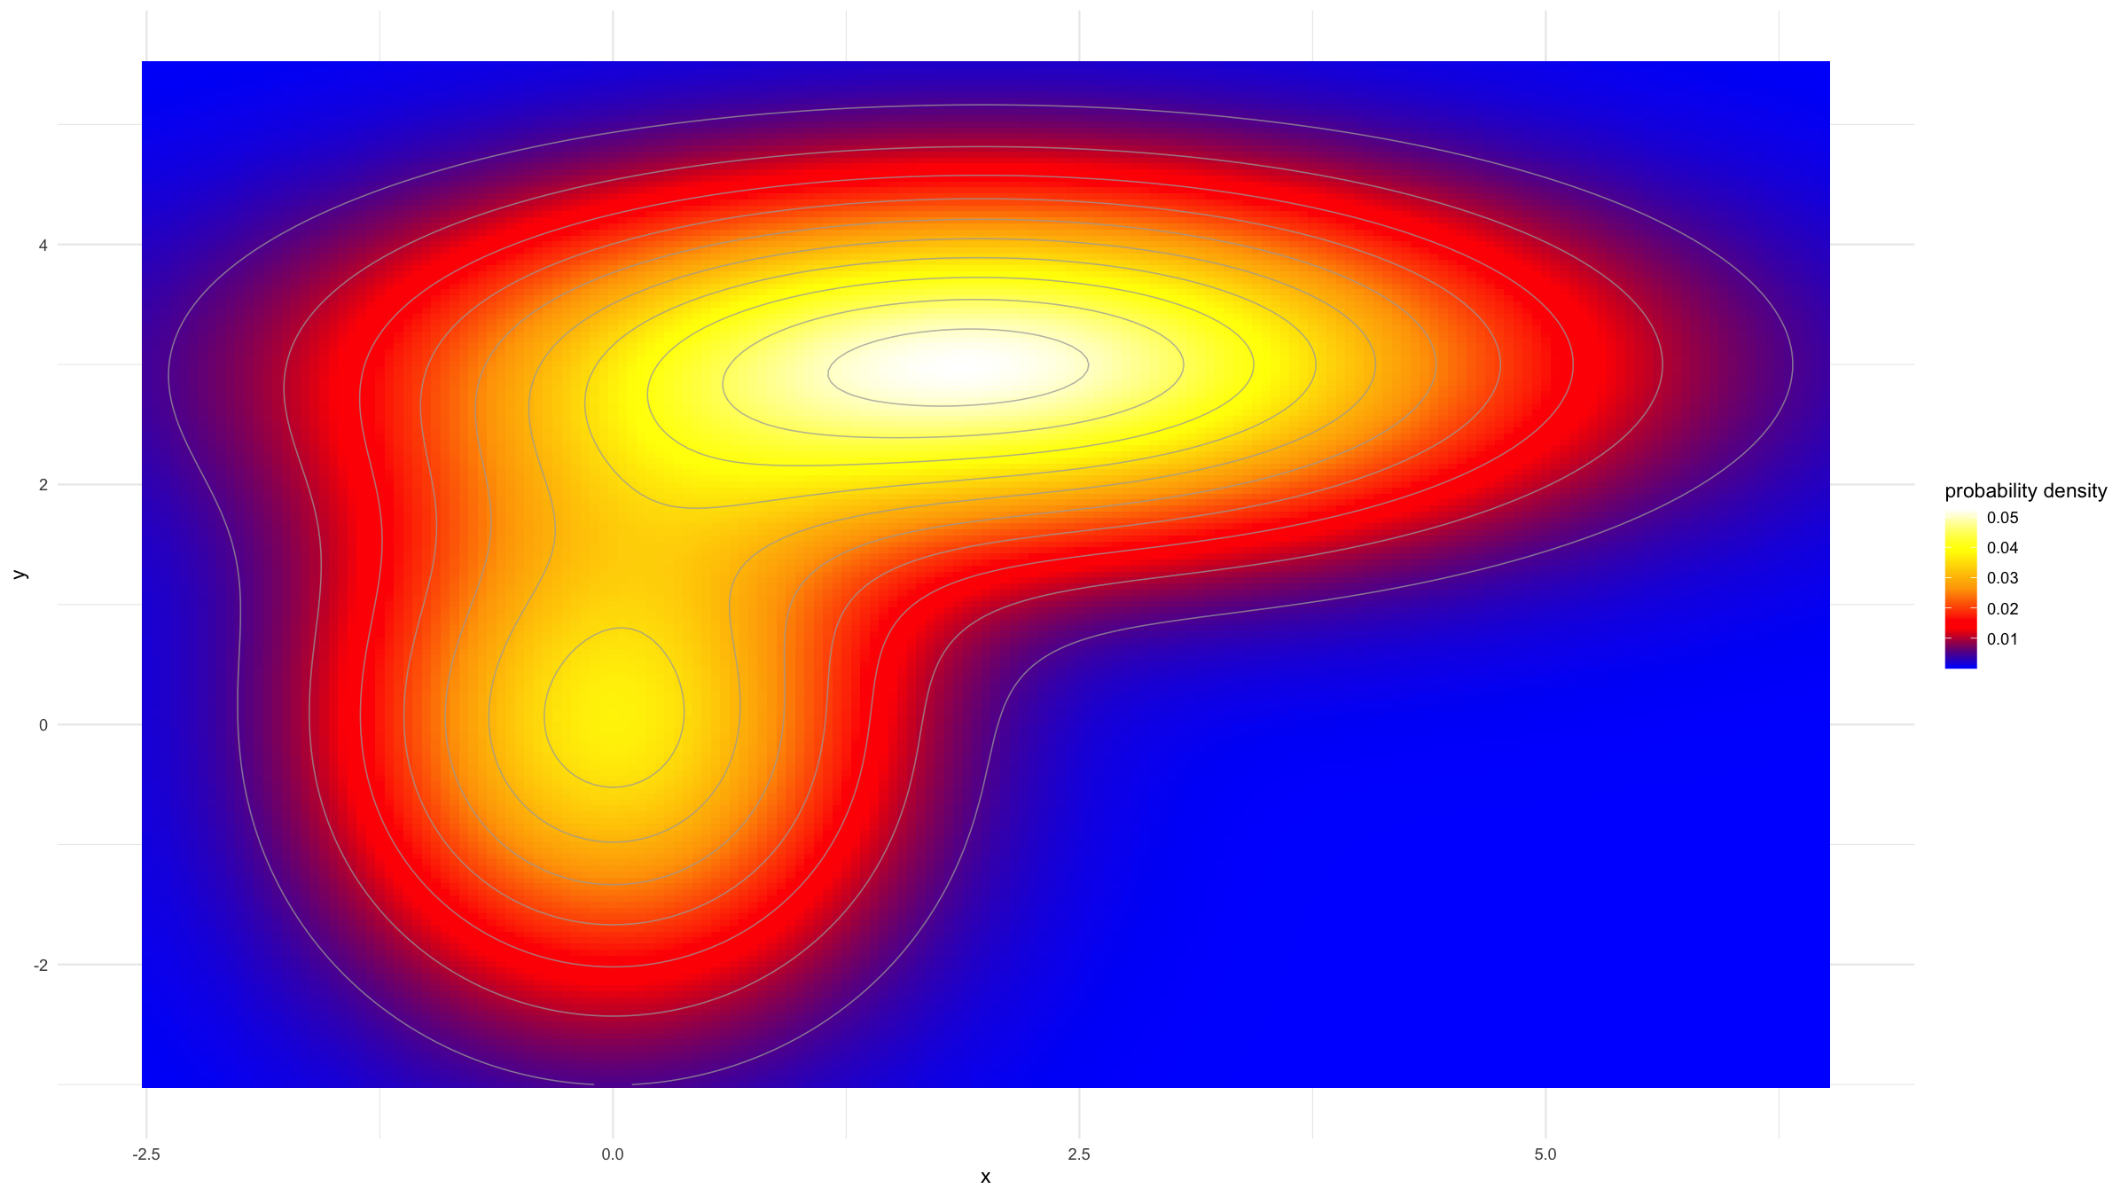
Covariation figures
You can combine heampaps and contour plots.
densSurf %>% ggplot(mapping=aes(x=x,y=y,fill=dens,z=dens)) + geom_tile(width=0.05,height=0.05) + geom_contour(col="darkgrey",lwd=0.35,alpha=0.75) + scale_fill_gradientn(colours = clrs(200),name="probability density") + theme_minimal()
## Warning: The following aesthetics were dropped during statistical transformation: fill ## ℹ This can happen when ggplot fails to infer the correct grouping structure in ## the data. ## ℹ Did you forget to specify a `group` aesthetic or to convert a numerical ## variable into a factor?

Slide 57
Multi-panel figures

Slide 58
Multi-panel figures
There’s multiple ways to generate multi-panel figures. Here we just cover 2 examples.
For a basic, but general way of combining multipe graphs onto the same figure, the function grid.arrange() from the R package gridExtra can be used.
The procedure is very simple:
Load the package (if not loaded already): library(gridExtra)
Assign each ggplot() call to an object (e.g. p1<-ggplot(...) + ...)
Produce a multipanel figure with grid.arrange(p1,p2,...,nrow=2)
The nrow parameter specifies over how many rows you want to arrange the plots.

Slide 59
Multi-panel figures
g1<-ggplot(data=dat,mapping=aes(x=type,y=x3)) + geom_boxplot() + geom_jitter(width=0.25,height=0,alpha=0.3) + xlab("") + ylab("Variable x3") + ggtitle("A box & jitter plot.") + theme_minimal()

Slide 60
Multi-panel figures
g2<-ggplot(data=dat,mapping=aes(x=x3,y=x4,col=type)) + geom_point() + geom_smooth() + scale_colour_manual(values=c("steelblue","salmon","orange"), name="Type") + xlab("Variable x3") + ylab("Variable x4") + ggtitle("A covariation plot.") + theme_light() + theme(text=element_text(size=14))

Slide 61
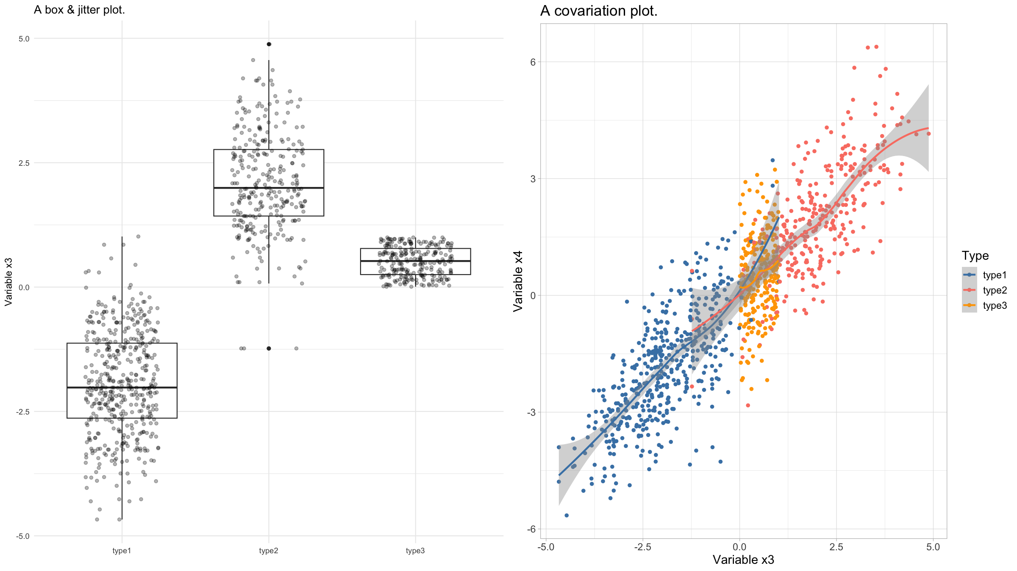
Multi-panel figures
grid.arrange(g1,g2,nrow=1)
## `geom_smooth()` using method = 'loess' and formula = 'y ~ x'

Slide 62
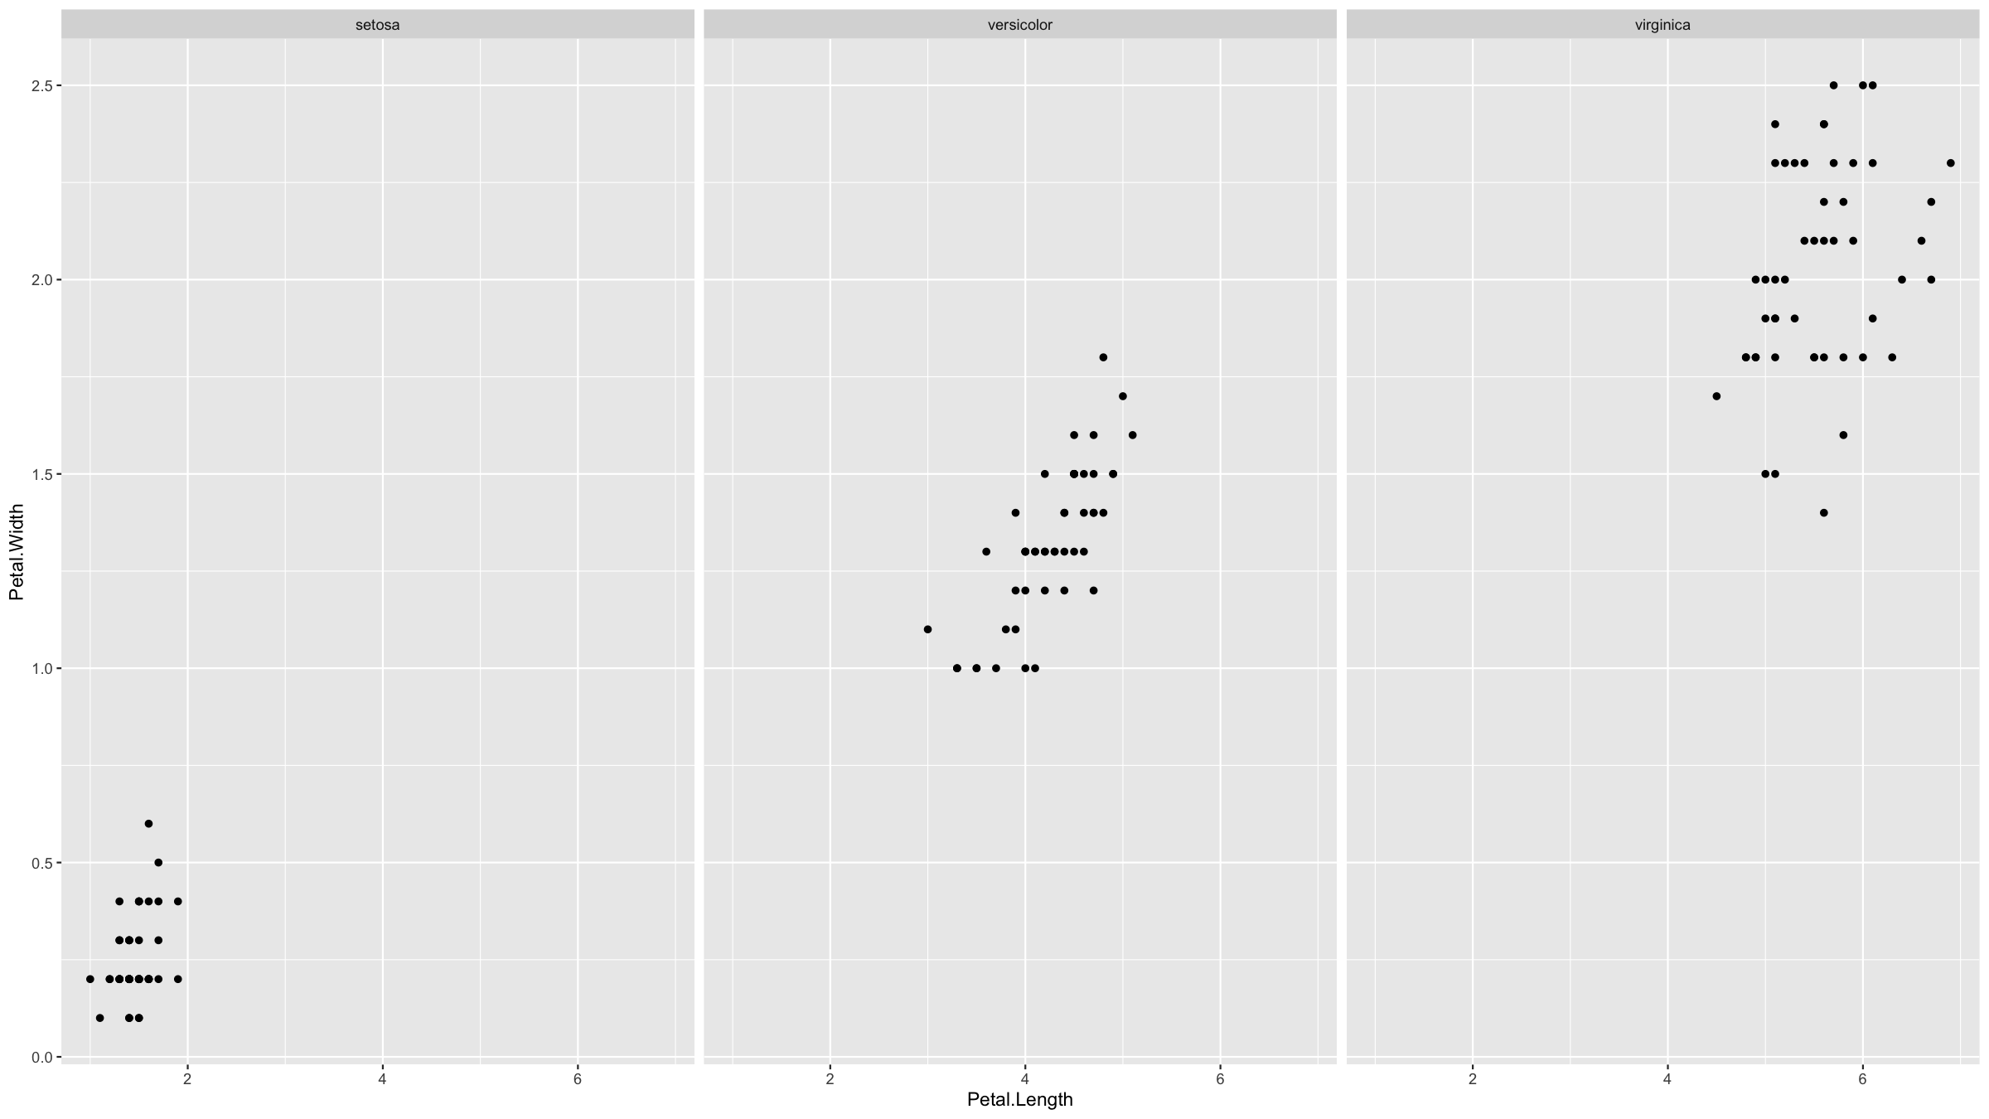
Multi-panel figures
The other approach we will cover, is if you want to repeat the same graph for different groups of observations within your dataset.
This is called faceting and in ggplot2 the function facet_wrap() allows to do this very easily.
iris %>% ggplot(mapping=aes(x=Petal.Length,y=Petal.Width)) + geom_point() + facet_wrap(~Species)

Slide 63
Saving graphs to files

Slide 64
Saving figures
In ggplot2, the simplest way to save graphs is to use the function ggsave().
ggsave(g1,filename="myplot.png",width=16,height=9,units="cm",dpi=450)

Slide 65
Saving figures
Another way is to enclose your plotting code inside a statement that specifies a graphics device. “Graphics device” means a pdf, png, jpg or other file.
Example:
pdf(width=16,height=9,file="myfile.pdf") # opens the device; pdf will produce vector graphics # plotting code here dev.off() # closes the device

Slide 66
Saving figures
Or:
png(width=16,height=9,units="in",res=450) # raster graphics # plotting code here dev.off()

Slide 67
[end of Session 2]

